Slide 1
Predicting jp morgan stock price
By: Michael Rozenvasser

Slide 2
Business problem
Build a machine learning algorithm to predict the price of JP Morgan stock in order to inform decision making for an asset management firm.

Slide 3
process
01
02
03
04
Feature engineering
data
Yahoo Finance
18 total features
supervised learning
Model evaluation
ARIMA, EMA Modelling, LSTM neural network
How did we actually do

Slide 4
Disclaimer!
1.) This is by no means investment advice
2.) Efficient Market Hypothesis, the ’random walk’
Notes:
This is by no means any form of investment advice. Predicting the price of a stock is an extremely difficult task to accomplish becuase if it wasn't, everyone would be rich. Changes in stock price reflect the release of new information, changes in market generally, or random movements. Stock prices are thus described as a "random walk" meaning each day's deviations from the central value are random and unpredicatble. But Despite these silly hypotheses that withstood the test od time difficulty we will try our best to predict JPM stock price based on many features.

Slide 5
initial steps

Slide 6
data
1.) Correlated Assets: (any type, not necessarily stocks, such as commodities, FX, indices, or even fixed income securities).
2.) Technical indicators - a lot of investors follow technical indicators. We will include the most popular indicators as independent features. Among them - 7 and 21 days moving average, exponential moving average, momentum, Bollinger bands, MACD.
3.) Fourier transforms - Along with the daily closing price, we will create Fourier transforms in order to generalize several long- and short-term trends. Using these transforms we will eliminate a lot of noise (random walks) and create approximations of the real stock movement. Having trend approximations can help the LSTM network pick its prediction trends more accurately.
4.) Autoregressive Integrated Moving Average (ARIMA) - This was one of the most popular techniques for predicting future values of time series data (in the pre-neural networks ages). Let's add it and see if it comes off as an important predictive feature.
Notes:
We need to understand what affects whether JPM stock price will move up or down. It is what people as a whole think. Hence, we need to incorporate as much information (depicting the stock from different aspects and angles) as possible. (We will use daily data - 1,585 days to train the various algorithms (70% of the data we have) and predict the next 680 days (test data). Then we will compare the predicted results with a test (hold-out) data. Each type of data (we will refer to it as feature) is explained in greater detail in later sections, but, as a high level overview, the features we will use are:
We need to understand what affects whether JPM stock price will move up or down. It is what people as a whole think. Hence, we need to incorporate as much information (depicting the stock from different aspects and angles) as possible. (We will use daily data - 1,585 days to train the various algorithms (70% of the data we have) and predict the next 680 days (test data). Then we will compare the predicted results with a test (hold-out) data. Each type of data (we will refer to it as feature) is explained in greater detail in later sections, but, as a high level overview, the features we will use are:

Slide 7
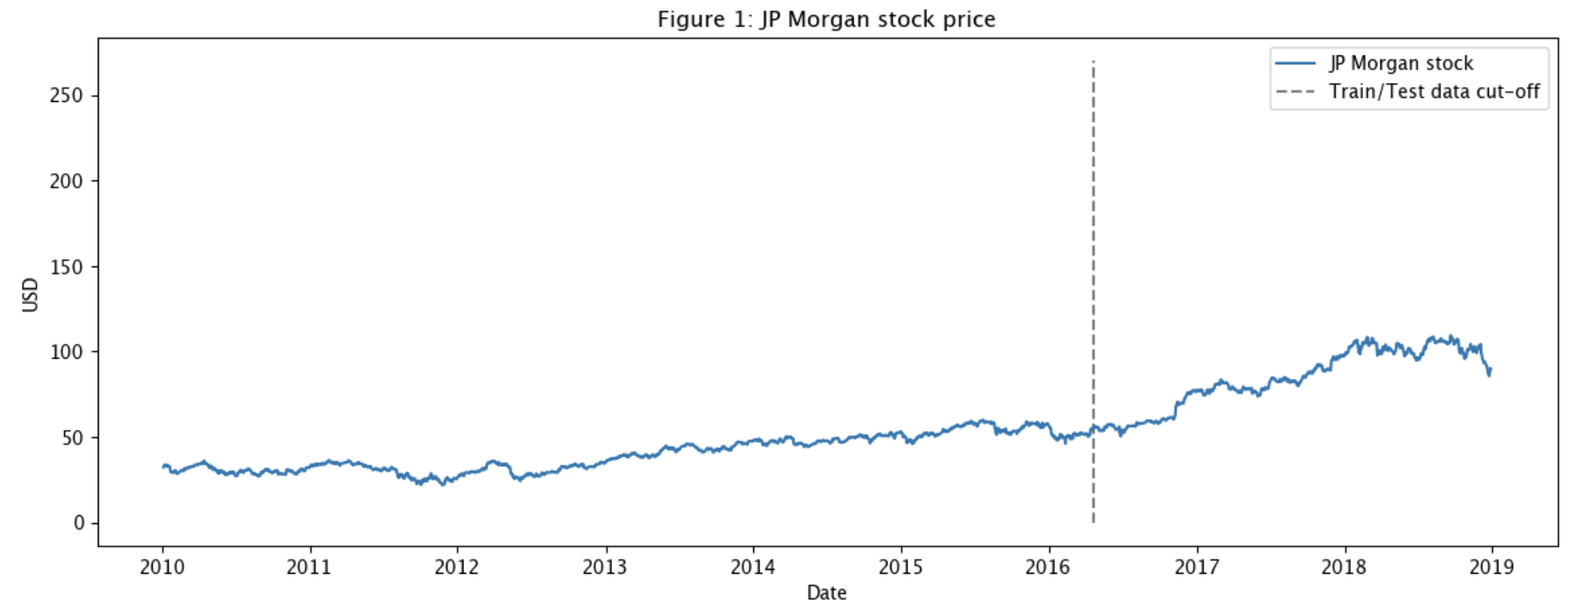
Test train split
Notes:
1600 training days 800 test days

Slide 8
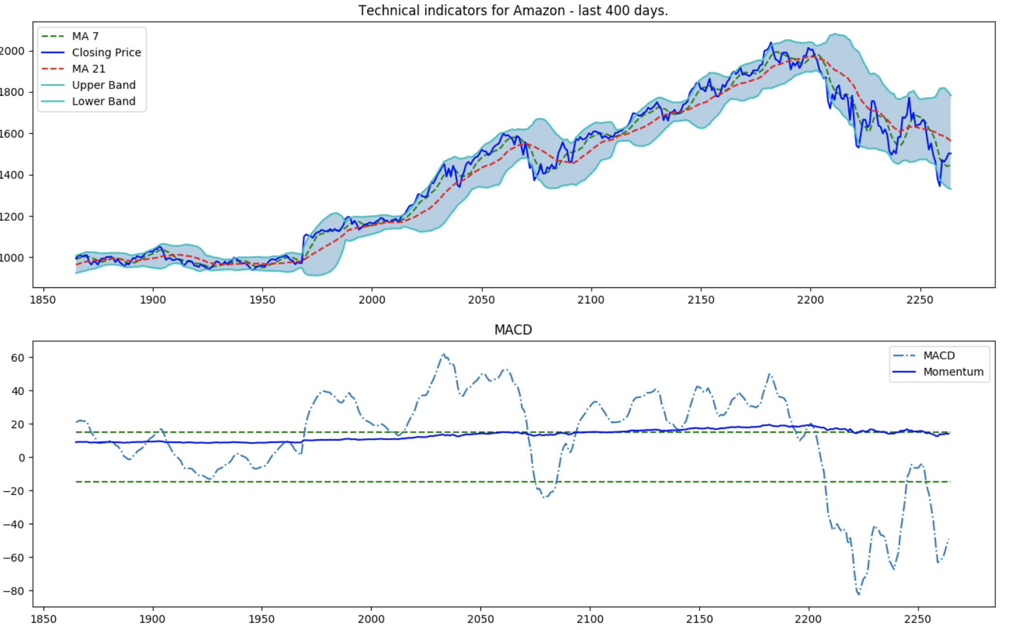
features
Notes:
List of technical indicators and explanation:
1. Bollinger bands: Bollinger Bands are a volatility indicator. Bands are consists of Moving Average (MA) line, a upper band and lower band.
2. EMA: Moving averages just average out the data for a given time so we know how the company's closing price are trending for a given amount of days. example for 4 days is price was 22,23 ,45,1 (the company crashed on 4th day) the average would be 23. Now 23 is a below average value so it gives us an idea that 45 was indeed just a fluke.
3. Momentum: It is the measurement of the speed or velocity of price changes, or the rate of change in price movement for a particular asset
Momentum=V−Vx where:
V=Latest price
Vx=Closing price
x=Number of days ago
THE FIRST PLOT IS SELF EXPLANATORY
THE SECOND PLOT IS SHOWING THE THRESHOLD BETWEEN MACD AND MOMENTUM. AS YOU CAN SEE MOMENTUM IS GIVING AN AVERAGE VALUE OF THE MACD IN BETEEEN THE PEAK VALUES AND THE HIGHEST OR LOWEST VALUES. MACD DEPENDS ON THE MOVING AVERAGE FEATURES AS CALCULATED ABOVE

Slide 9
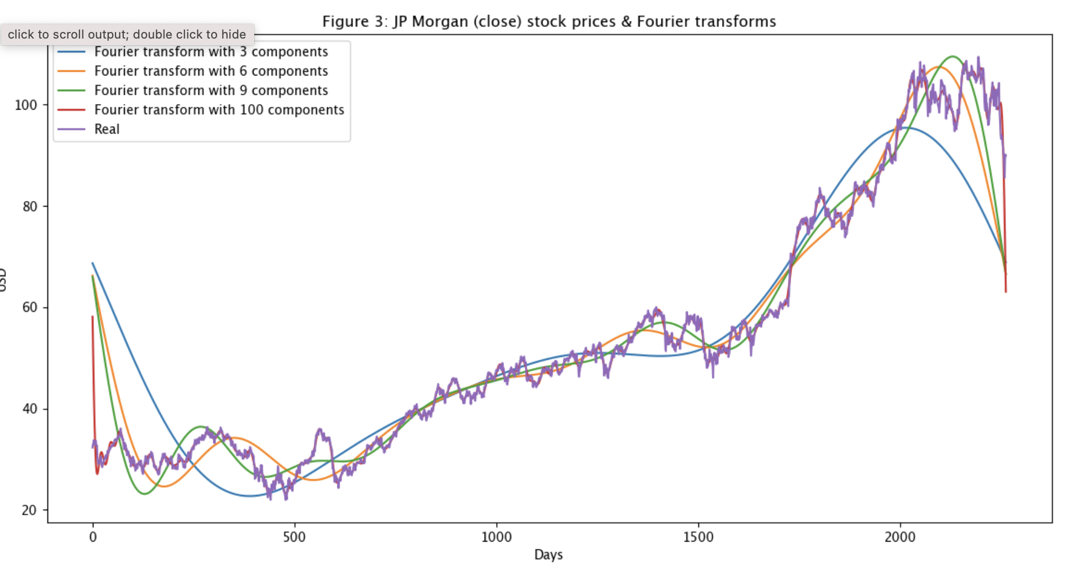
Fourier transforms
Notes:
Fourier Transform uses many spectral components to try and train data. From time domain its converted to frequency domain and then calculated. After that it's reconverted into time domain where it's plotted. Fourier Transform as indicator helps to extract predominate cycle from a series of data
Ith 100 is the best so we move in with taht

Slide 10
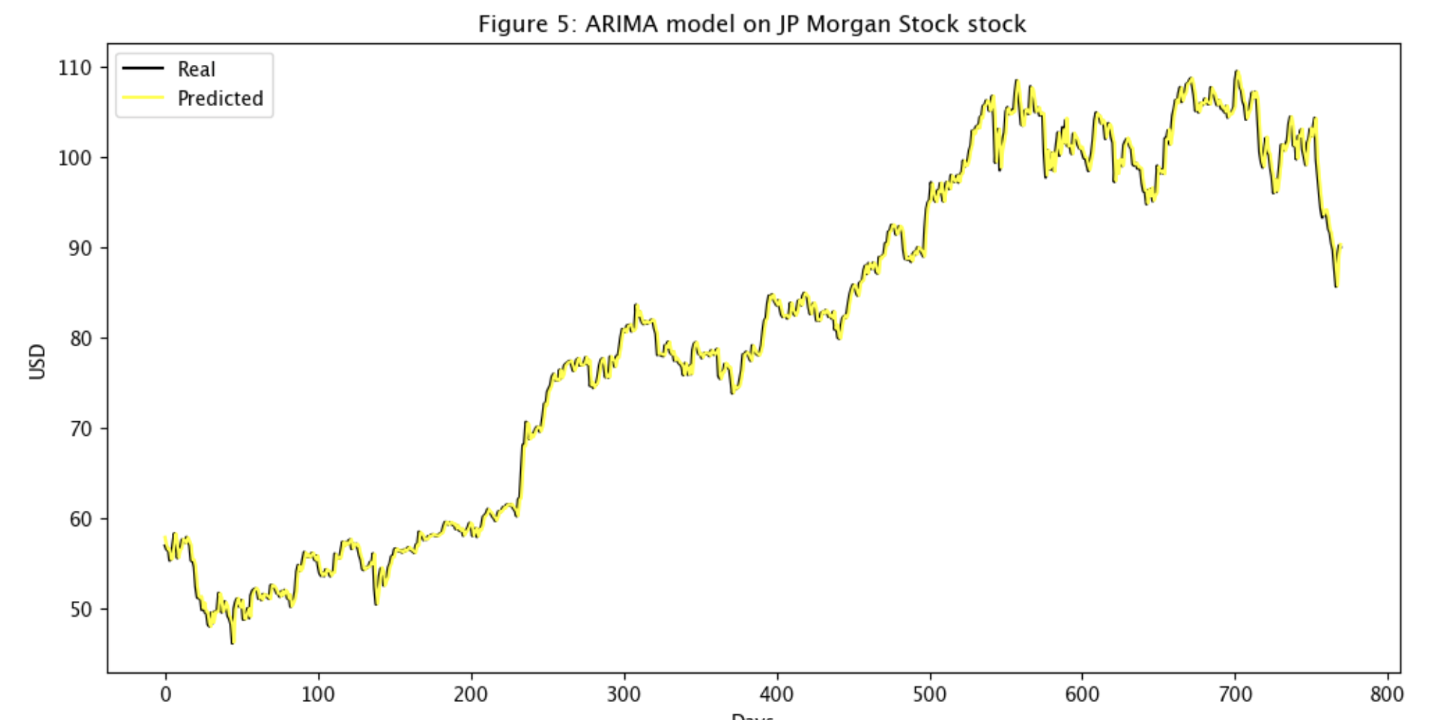
Arima as a feature
Notes:
ARIMA as a feature:
Autoregressive Integrated Moving Average (ARIMA) — This was one of the most popular techniques for predicting future values of time series data (in the pre-neural networks ages). Let’s add it and see if it comes off as an important predictive feature.
ARIMA is a technique for predicting time series data. We will show how to use it, and all though ARIMA will not serve as our final prediction, we will use it as a technique to denoise the stock a little and to (possibly) extract some new patters or features.

Slide 11
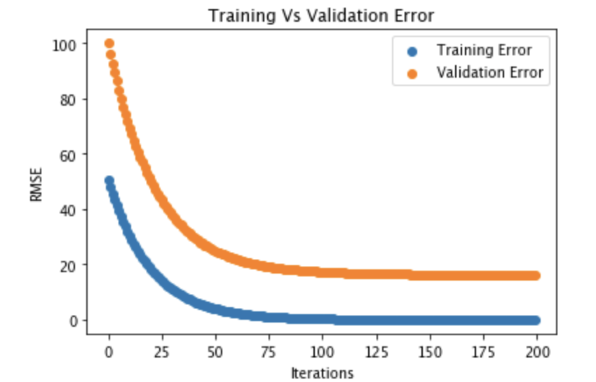
Underfit model
Notes:
There is a difference between validation and training error which may be indicative of an underfit model. This may be due to the how the data was split up as JPM price increased greatly during the test data portion.

Slide 12
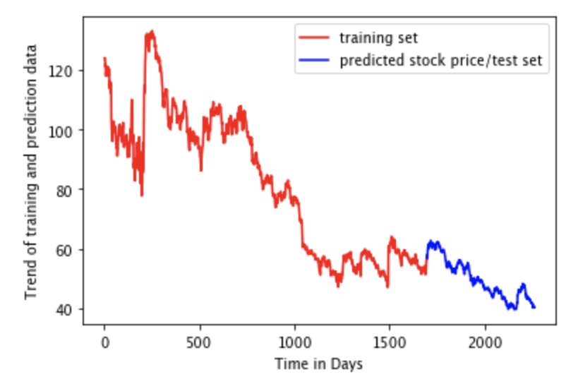
Model results
MAE: 0.077
Train RMSE: 1.29
Test RMSE: 0.9
Last Day Value:40.3
Next Day Value:39.74
Notes:
Our prediction plot has kept up with trend and it doesn’t look to bad but when we look at actual JPM stock price it is quite the opposite, JPM started booming as the color changes from red to blue
Conclusion LSTM does not do a good job at predicting day to day values and the way the test and training data was split I was set up for failure

Slide 13
Generating Stock Price Movement
Notes:
MISTAKES OF PREVIOUS NOTEBOOK:
1. OVERFITTING DUE TO LIMITED DATASIZE
2. EXCESSIVE FEATURE EXTRACTION
3. HAVING WRONG PREDICTIONS DUE TO WRONG TYPE OF NORMALIZATION
4. NO HYPERPARAMTER TUNING

Slide 14
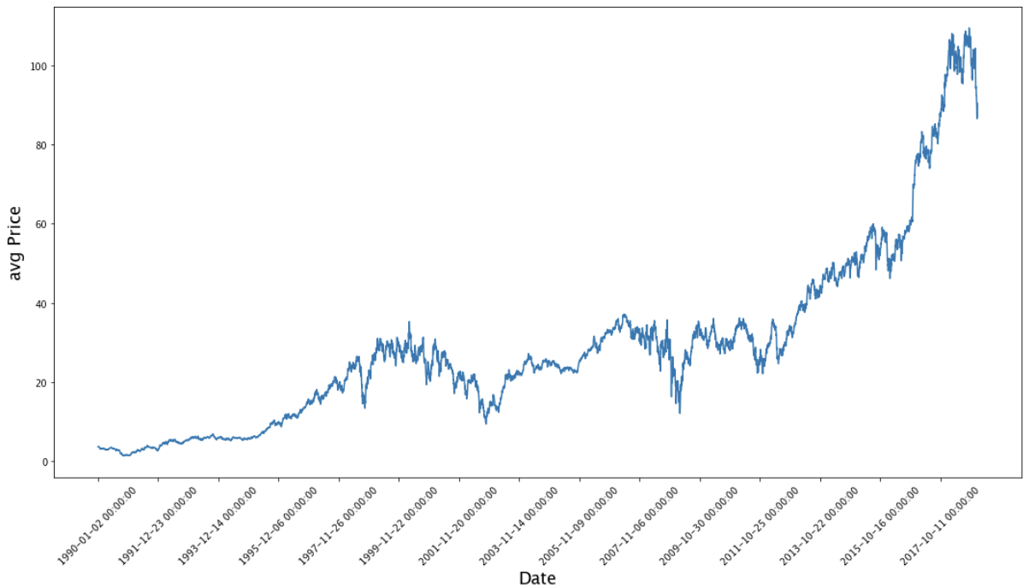
New model
Notes:
Still JPM stock price but I am getting data since inception. The data is easier ot observe and see the progress of JPM. Train 6000 test 1000

Slide 15
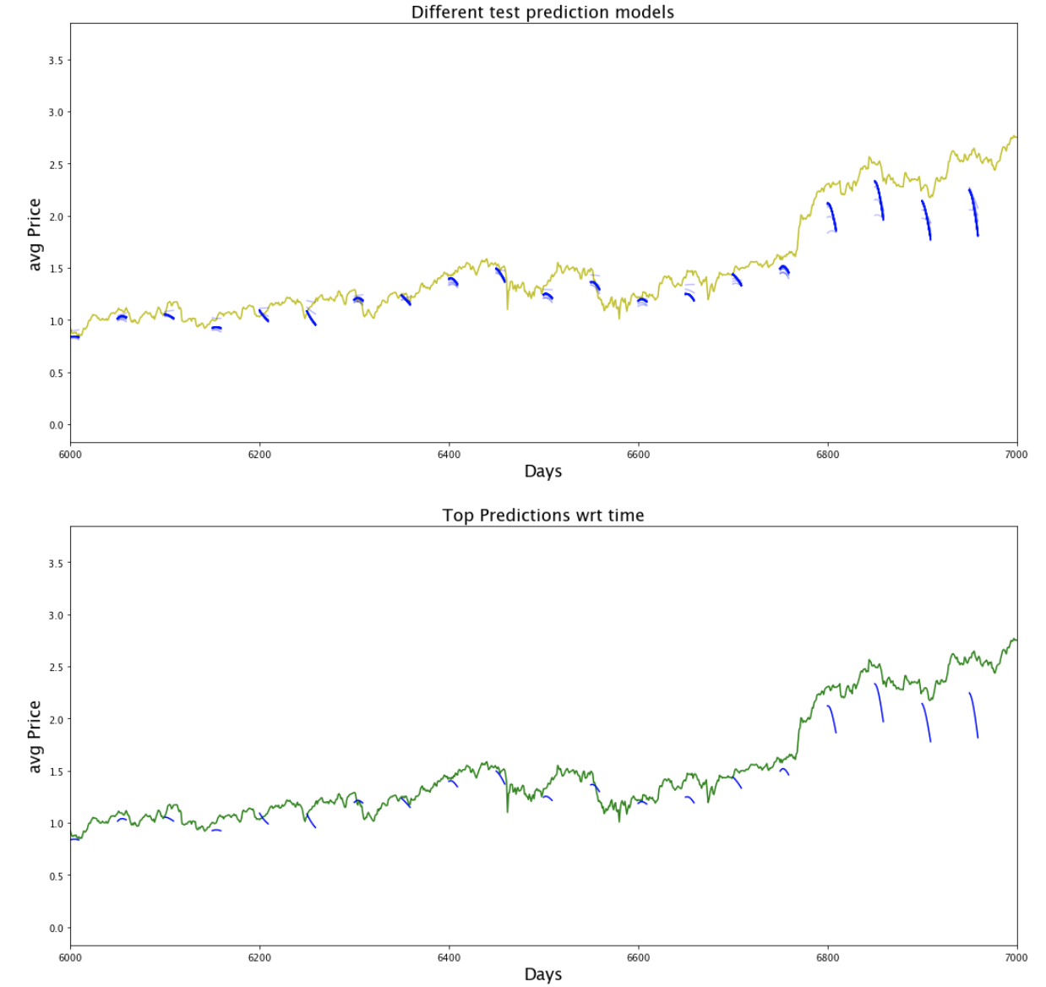
results
Notes:
For this model instead of feature generation I normalized average prices and try to predict based on them instead of feature enginerring.
generate data and labels
generate simple full length data and labels and make an array for indices using closing prices
use this generated rolled out batches as input for LSTM
the input will be the data and output will be the labels based on the prices
Run on 50 epochs, 100 epochs was killing my kernel
##### We predict stock price movements and not stock price over time
#### The blue ticks indicate changes in the stock price movement i.e. their momentum
#### This is calculated by splitting the unroll sequence generator
#### The Y axis between 0 and 3.5 and all price movement are between them.
#### But our LSTM model is not predicting very well . It seems to capture the downward trends better than upwards ones.
#### But generally over a longer time LSTM can detect stock price movements much better than it can detect stock prices

Slide 16
Next steps
GAN for stock market prediction
Use accuracy as measure instead of MAE and change the regression problem into a classification problem.
Notes:
There aren’t many applications of GANs being used for predicting time-series data as in our case. The main idea, however, should be same — we want to predict future stock movements. In the future, the pattern and behavior of jpm stock should be more or less the same
Generative Adversarial Networks (GAN) have been recently used mainly in creating realistic images, paintings, and video clips.

Slide 17
Thank you! Any questions?

